Slide 1
Notes on Pythagorean Theorem
Turn to pages 86 & 87 in your notebook. Fill in the missing information.
View these slides in presentation mode

Slide 2
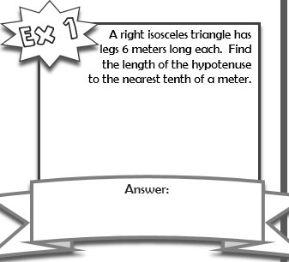
Using Pythagorean Theorem
So far we have practiced using the Pythagorean Theorem to find the length of the hypotenuse of a right triangle when given the lengths of the other sides
$$a^{2}+b^{2}=c^{2}$$
$$6^{2}+6^{2}=c^{2}$$
$36+36=$72
C=$\sqrt{72}$≈ 8.5 meters

Slide 3
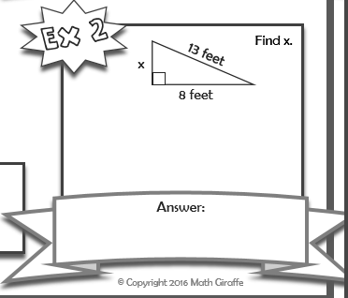
How else can the Pythagorean theorem be used?
We can also find the length for any of the missing sides as long as we have lengths for one side and the hypotenuse.
This will require that we rearrange the formula.
For instance if I need to find the length of side a then I would rewrite the equation as $a^{2}=c^{2}$ - $b^{2}$ or if I need to find the length of side b then I would rewrite the formula as $b^{2}=c^{2}$ - $a^{2}$
So try the example to the right and then check your answer
$a^{2}=c^{2}$- $b^{2}$
$a^{2}={13}^{2}$- $8^{2 }$
$a^{2}=169$- $64$
$a^{2}=$105
a = $\sqrt{105}$≈ 10.2 ft

Slide 4
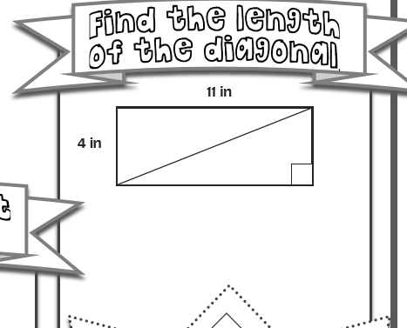
Using the Pythagorean Theorem to find the length of a diagonal
We can use the Pythagorean Theorem to find the length of a diagonal of a rectangle or square as well.
See how the diagonal creates 2 right triangles inside the rectangle
The diagonal is always the hypotenuse of a right triangle.
So all we need to do is label the right triangle correctly and then solve for c using the formula $a^{2}+b^{2}=c^{2}$
b =
a =
c = ?
$$a^{2}+b^{2}=c^{2}$$
$$4^{2}+{11}^{2}=c^{2}$$
$$16+121=137$$
C²= 137 so c= $\sqrt{137}$
c≈ 11.7 in

Slide 5
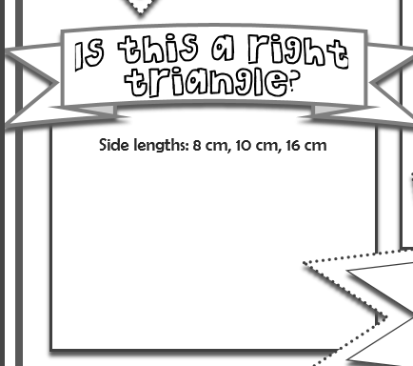
Is the triangle a right triangle?
If you are given all the lengths of a triangle you can determine if it is a right triangle.
If the two smaller sides are squared and then added together equal the square of the longest side then you have a right triangle.
If they do not equal each other then you don’t have a right triangle
Try the example and then check
8² + 10² = 64 + 100 = 164
16² = 256
164 ≠ 256
8² + 10² ≠ 16²
So this is not a right triangle

Slide 6
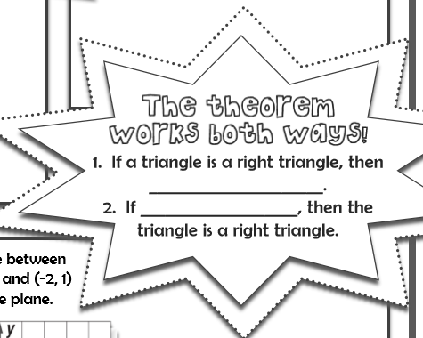
Is the triangle a right triangle?
Here’s another example this time showing that the triangle is a right triangle.
Is a triangle with sides 3,4,5 a write triangle?
To determine this I will square the smaller sides of the triangle and add them together. Then I will square the largest side. If the two values equal each other than I have a right triangle.
So, 3² + 4² = 9 + 16 = 25 and 5² = 25
3² + 4² = 5² because 25 = 25 so I have a right triangle
$$a^{2}+b^{2}=c^{2}$$
$$a^{2}+b^{2}=c^{2}$$

Slide 7
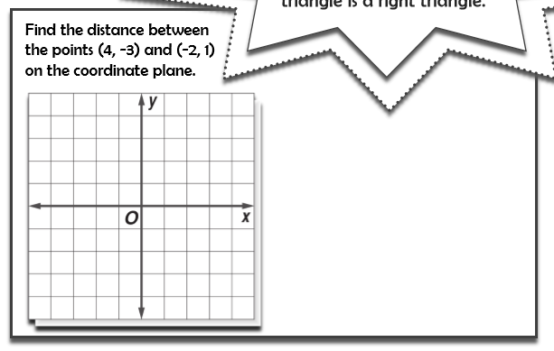
Using the Pythagorean theorem to find the distance between two points
You can also use the Pythagorean theorem to find the distance between two points.
First plot the points
Then draw a line between the two points.
Make a right triangle from the line
To find the lengths of the sides count the number of units long the y axis and the number of units along the x axis and use these values.
Then substitute the values into the formula for a and b to solve for c.
Plot the points
Make a right triangle
from the points
Substitute values into
formula
$$a^{2}+b^{2}=c^{2}$$
$$4^{2}+6^{2}=c^{2}$$
$${16}^{2}+{36}^{2}={52}^{}$$
c = $\sqrt{52}$ ≈ 7.2
4
Units
along
y axis
6 units along x axis

Slide 8
Now let’s practice
Get the practice sheet from the front desk. Complete each of the four types of problems. Then check your answers using the next series of slides. Be sure to show all your work and make any corrections to your paper.

Slide 9
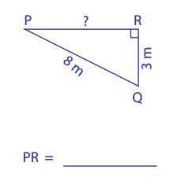
Finding the length of a side other than the hypotenuse
b
a
First label each side a, b, c
Rewrite the formula so that
you are solving for the square of
the missing side.
$b^{2}=c^{2 }$- $a^{2}$
Substitute in the known values
$b^{2}={15}^{2 }$- ${12}^{2}$
$b^{2}=225$- $144$
$b^{2}=81$ so b = $\sqrt{81}$ = 9 cm
c
c
a
7.4 m
b
First label each side a, b, c
Rewrite the formula so that
you are solving for the square of
the missing side.
$b^{2}=c^{2 }$- $a^{2}$
Substitute in the known values
$b^{2}=8^{2 }$- $3^{2}$
$b^{2}=64$- $9$
$b^{2}=55$ so b = $\sqrt{55}$ ≈ 7.4 m
9 cm

Slide 10
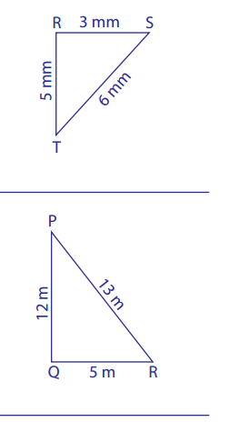
Determining if it is a right triangle
a
Label the sides of the triangle
Find the sum of the squares of the two smaller sides
If they equal the square of the hypotenuse it is a right triangle
$a^{2}+b^{2}=c^{2}$ $3^{2}+5^{2}=$ 9 + 25 = 34 and $6^{2}=c^{2}$ = 36
34 ≠ 36 so $a^{2}+b^{2}≠c^{2}$ so this is not a right triangle
b
c
Label the sides of the triangle
Find the sum of the squares of the two smaller sides
If they equal the square of the hypotenuse it is a right triangle
$a^{2}+b^{2}=c^{2}$ $5^{2}+{12}^{2}=$ 25 + 144 = 169 and ${13}^{2}=c^{2}$ = 169
169 = 169 $a^{2}+b^{2}=c^{2}$ so this is a right triangle
c
b
a

Slide 11
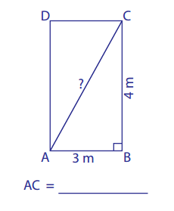
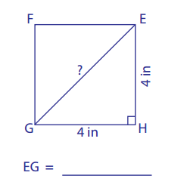
Find the diagonal of a shape
Remember the diagonal is the hypotenuse to the right triangle
c
First label each side of the triangle a, b, c
Write the formula $a^{2}+b^{2}=c^{2}$
Substitute in the known values and solve for c
$$4^{2}+4^{2}=c^{2}$$
$$16+16=c^{2}$$
$$32=c^{2}$$
$\sqrt{32}=c^{}$≈ 5.7 in
b
c
a
a
5 m
b
First label each side of the triangle a, b, c
Write the formula $a^{2}+b^{2}=c^{2}$
Substitute in the known values & solve for c
$$3^{2}+4^{2}=c^{2}$$
$$9+16=c^{2}$$
$$25=c^{2}$$
$\sqrt{25}=c^{}$≈ 5 m
5.7 in

Slide 12
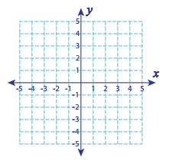
Find the distance between two points
$\sqrt{13}$ = c ≈ 3.6
(4,5) and (2,2)
Plot the points
Connect the two points with a line
Draw a triangle
Label the sides
Count the number of units down for one side of the triangle
Count the number of units for the other side of the triangle
Substitute these values into the Pythagorean formula and solve for c
$$a^{2}+b^{2}=c^{2}$$
$$2^{2}+3^{2}=c^{2}$$
$$4+9=c^{2}$$
$$13=c^{2}$$
$\sqrt{13}$ = c ≈ 3.6
c
b= 3
a= 2

Slide 13
Find the distance between two points
(-3,4) and (1,3)
Plot the points
Connect the two points with a line
Draw a triangle
Label the sides
Count the number of units down for one side of the triangle
Count the number of units for the other side of the triangle
Substitute these values into the Pythagorean formula and solve for c
$$a^{2}+b^{2}=c^{2}$$
$$1^{2}+4^{2}=c^{2}$$
$$1+16=c^{2}$$
$$17=c^{2}$$
$\sqrt{17}$ = c ≈ 4.1
$\sqrt{17}$ = c ≈ 4.1
c
a= 1
b= 4

Slide 14
Put this paper in your notebook when completed.

