Slide 1
Estimating Square roots without a calculator

Slide 2
What is the square root of the number below?
$\sqrt{29}$≈?
What are the steps we use to determine the approximate square root of this number?

Slide 3
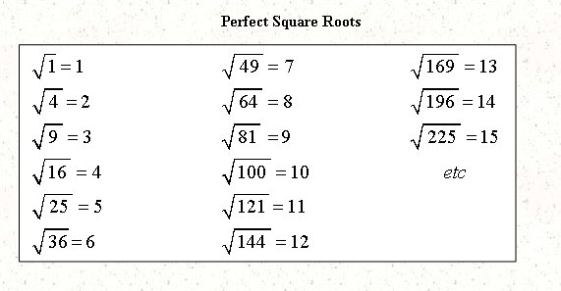
Step 1: Determine that the number is not a perfect square.
Remember a perfect square is a number whose square root is a whole number integer.
You need to memorize these so,
Say each of the equations in the
chart to yourself.
Notice 29 is not
on this chart.
So it is not a perfect
square. This means its
root is not just a whole
number.

Slide 4
Step 2: Determine the perfect squares that your number falls between and find their square roots.
For example if you are asked to find the square root of 29, what are the perfect square numbers that it falls between?
Larger
Smaller
So at the very least we
Know that the square root of 29 will be in between 5 and 6.
36
25
29
$\sqrt{25 }$ = 5
$\sqrt{36 }$ = 6

Slide 5
Step 3: Determine the whole number part of our answer.
The square root of the smaller perfect square will be the whole number part of our answer
25
29
$\sqrt{25 }$ = 5
$\sqrt{29 }$ = 5

Slide 6
Step 4: Determine the fractional part of our answer.
Now we need to find out approximately how much more over 5 the square root of 29 is. To do this we can use the following proportion
$$\frac{\begin{aligned} \\ our number−the lower perfect square\end{aligned}}{The larger perfect square−the smaller perfect square}$$
$\frac{29−25 }{36−25}$ = $\frac{4}{11}$
36
So the $\sqrt{29 }$ ≈ 5$\frac{4}{11}$
25
29

Slide 7
Let’s practice by working some examples
Use the page provided to complete each of the three examples.

Slide 8
Example- Work out on the paper given
Example
Solution
$$\sqrt{24}$$
24 is between 16 and 25
$\sqrt{16}$ = 4, and $\sqrt{25}$ = 5
$\sqrt{24}$ = 4 and
$\frac{24−16}{25−16}$ =$\frac{8}{9}$
$\sqrt{24}$ ≈ 4 $\frac{8}{9}$

Slide 9
Example- Work out on the paper given
Example
Solution
$$\sqrt{63}$$
63 is between 49 and 64
$\sqrt{49}$ = 7, and $\sqrt{64}$ = 8
$\sqrt{63}$ = 7 and
$\frac{63−49}{64−49}$ =$\frac{14}{15}$
$\sqrt{63}$ ≈ 7 $\frac{14}{15}$

Slide 10
Example- Work out on the paper given
Example
Solution
$$\sqrt{95}$$
95 is between 81 and 100
$\sqrt{81}$ = 9, and $\sqrt{100}$ = 10
$\sqrt{95}$ = 9 and
$\frac{95−81}{100−81}$ =$\frac{14}{19}$
$\sqrt{95}$ ≈ 9 $\frac{14}{19}$

Slide 11
Finished? Think you got this?
Go and ask Ms. Sieruta for the quiz to see.

