Slide 1
Alternate & Same Side Angles

Slide 2
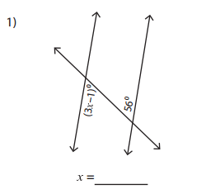
Side 1 Alternate & Same Side Angles
Find the value of x
Solution
The two angles are congruent because they are alternating interior angles.
Write the equation
$3x−1=56$
Solve for x
$3x−1=56$
$+1= +1$
$3x=57$
$\frac{3x}{3}$= $\frac{57}{3}$
$x=19$
First mark
which angles
are congruent.
Dots indicate congruent angles

Slide 3
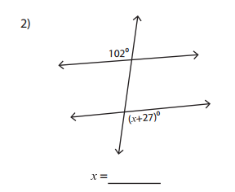
Find the value of x
Solution
The two angles are congruent because they are alternating exterior angles.
Write the equation
$x+27=102$
Solve for x
$x+27=102$
$−27=−27$
$x=75$
First mark
which angles
are congruent.
Dots indicate congruent angles

Slide 4
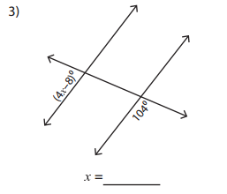
Solve for x
Solution
Realize that the two angles are actually supplementary angles so they will add up to 180°
Write the equation
$4x−8+104=180$
Combine like terms
$4x+96=180$
Solve for x
$4x+96=180$
$−96=−96$
$4x=84$
$\frac{4x}{4}=\frac{84}{4}$
X=21
supplementary
First mark
which angles
are congruent.
Dots indicate congruent angles

Slide 5
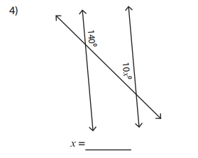
Find the value of x
Solution
Realize that the two angles are actually supplementary angles so they will add up to 180°
Write the equation
$10x+140=180$
Solve for x
$10x+140=180$
$−140=−140$
$10x=40$
$\frac{10x}{10}=\frac{40}{10}$
X=4
First mark
which angles
are congruent.

Slide 6
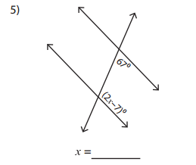
Solve for x
Solution
Realize that the two angles are actually supplementary angles so they will add up to 180°
Write the equation
$2x−7+67=180$
Combine like terms and solve for x
$2x+60=180$
$−60=−6$0
$2x=120$
$\frac{2x}{2}=\frac{120}{2}$
X=60
First mark
which angles
are congruent.

Slide 7
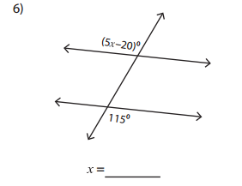
Solve for x
Solution
The two angles are congruent because they are alternating exterior angles.
Write the equation
$5x−20=115$
Solve for x
$5x−20=115$
$+20=+20$
$5x=135$
$\frac{5x}{5}=\frac{135}{5}$
X=27
First mark
which angles
are congruent.

Slide 8
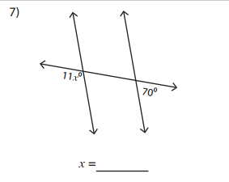
Find the value of x
Solution
Realize that the two angles are actually supplementary angles so they will add up to 180°
Write the equation
$11x+70=180$
Solve for x
$11x+70=180$
$−70=−7$0
$11x=110$
$\frac{11x}{11}=\frac{110}{11}$
X=10
First mark
which angles
are congruent.

Slide 9
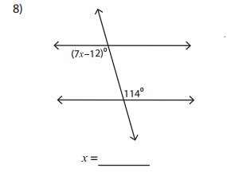
Find the value of x
Solution
The two angles are congruent because they are alternating interior angles.
Write the equation
$7x−12=114$
Solve for x
$7x−12=114$
$+12= +12$
$7x=$126
$\frac{7x}{7}$= $\frac{126}{7}$
$x=18$
First mark
which angles
are congruent.

Slide 10
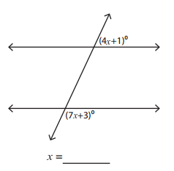
Worksheet Side 2
Find the value of x
Solution
supplementary
The sum of the angles will equal 180
Write the equation
$$\left(4x+1\right)+\left(7x+3\right)=180$$
Combine like terms
$11x+4=180$
Solve this two step equation for x
$$11x+4=180$$
$$−4=−4$$
$$11x=176$$
$$\frac{11x}{11}=\frac{176}{11}$$
$$x=16$$
First mark
which angles
are congruent.
Dots indicate congruent angles

Slide 11
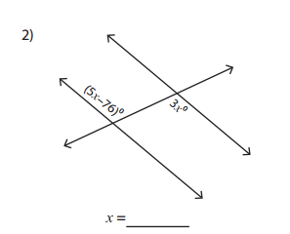
Find the value of x
Solution
These angles are alternating interior angles so they are congruent
Write the equation
$5x−76=3x$
Move variables to one side and constants to the other
$5x−76=3x$
$−5x =−5x$
$−76=−2x$
solve for x
$\frac{−76}{−2x}=\frac{−2x}{−2}$
38=x
First mark
which angles
are congruent.

